Slide 1
Academic Resilience
Introducing….
Notes:
This is a presentation for you to pick and choose slides from depending on what you wish to achieve at your Resilience Zap event.

Slide 2
This presentation
Introduce Academic Resilience and the concepts behind it
Why it matters
What a school can do to promote it
Think about how well we are doing as a school
Some things to try

Slide 3
Resilience can be thought of as
Normal development under difficult circumstances. Relative good result despite experiences with situations that have been shown to carry substantial risk for the development of psychopathology (Rutter)
Ordinary magic in the minds, brains and bodies of children, in their families and relationships and in their communities (Masten)
An emergent property of a hierarchically organised set of protective systems that cumulatively buffer the effects of adversity and can therefore rarely, if ever, be regarded as an intrinsic property of individuals (Roisman et al)
Notes:
There are lots of theories and concepts in the resilience field – here are some key ideas by some very brainy boffins who have researched and written about what it means…..but don’t be put off or spend too long trying to unravel these approaches – we have attempted to take the best of many of the theories and make it real and simple for schools to get their heads round without having to spend hours reading, so press on….

Slide 4
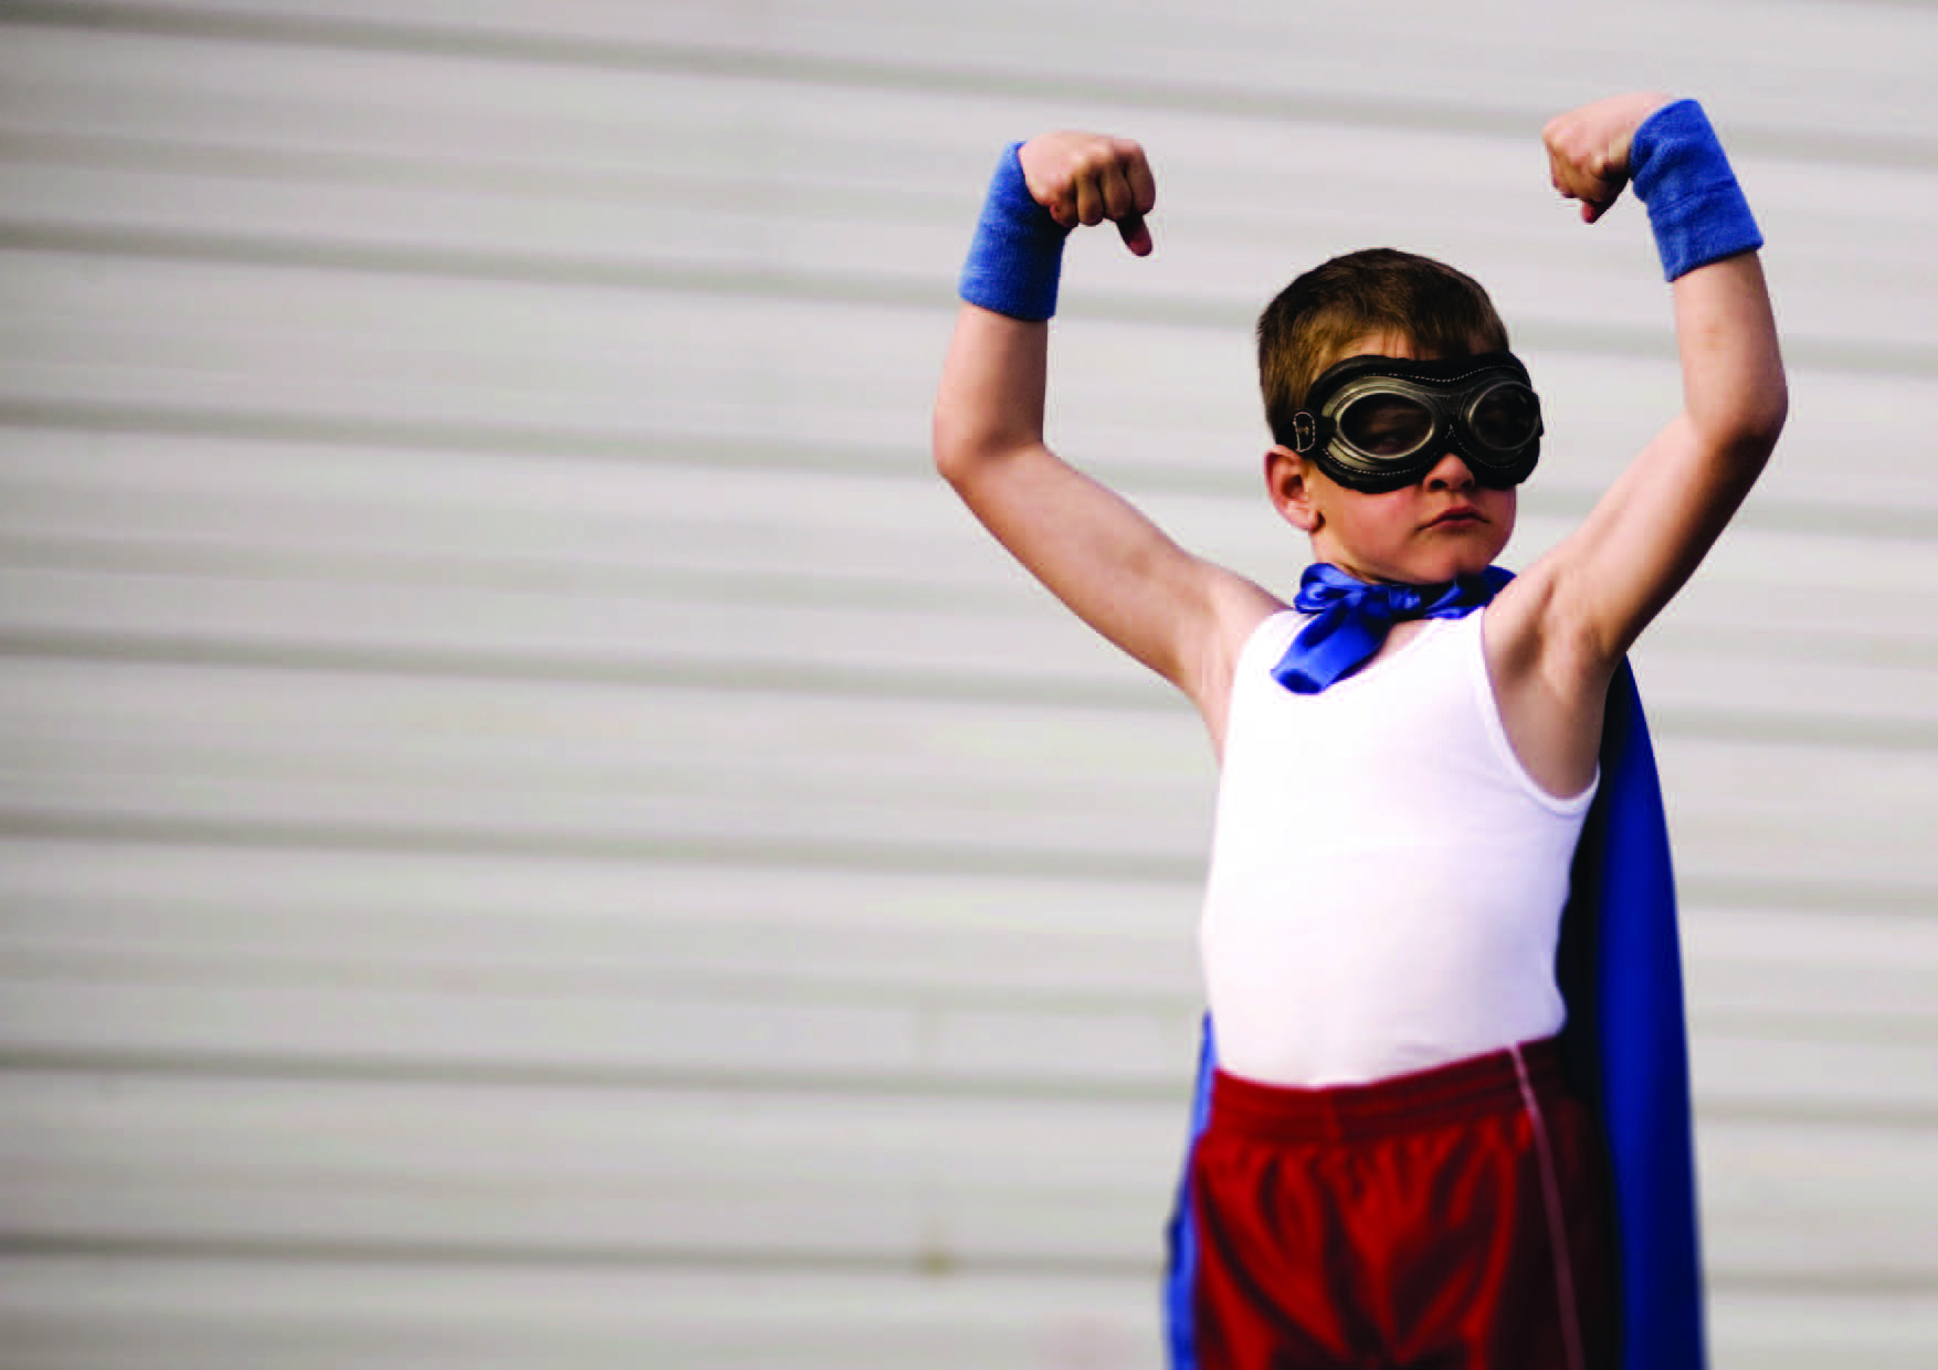
Some key ideas…
Better than expected outcomes – in a context of adversity
Bouncing back/up
Asset or strength focused
Compensatory experience – mitigating
Notes:
Here are some of the key ideas that are associated with resilience.
Context of adversity can mean anything from living in poverty to disability, from parental substance misuse to a boy being very small for his age!
Bouncing back means when things go wrong or get difficult, there is an ability and support to bounce back
It’s about building strengths rather than looking for, diagnosing and trying to fix problems (many of which can not be fixed!)
Its about filling gaps and building up children who have maybe lacked what other more children with more social capital have – such as supportive and attentive parents or nice holidays and experiences, or help to learn how to manage feelings

Slide 5
Academic resilience
Academic resilience means students achieving good educational outcomes despite adversity. For schools, promoting it involves strategic planning and detailed practice involving the whole school community to help vulnerable young people do better than their circumstances might have predicted.
Notes:
Here is our definition of AR. It was put together very carefully – thinking about all the concepts out there and what that might actually mean for a school in terms of helping disadvantaged pupils to do better than you might have expected them to do. It is important to note that we are suggesting that this is a whole school/whole organisation approach and will require both broader strategic work (workforce, structure, roles, data collation) alongside promoting interactions between adults and pupils which are detailed and based on evidence of what works.

Slide 6
Link between academic achievement and resilience
It is now well evidenced that early intervention in emotional difficulties improves outcomes for children, families and wider society including
increased learning and educational attainment,
improved behaviour and attendance at school,
better physical health
improved long term mental health.
Notes:
this is why you should bother – because it is all about helping to close the gap particularly but the knock on effect across school is that it will help ALL pupils do better

Slide 7
Resilience research
Resilience is highly correlated with academic achievement and educational success (Werner and Smith 1992).
Research identifies protective factors that buffer risk – all of which can be provided in or through school, such as caring relationships, positive and high expectations, and opportunities to participate and contribute (Benard,1991).
Studies suggest that children from high risk backgrounds who form attachments with a confiding adult outside their immediate family are more resilient to the effects of family adversity. Fergusson and Horwood (2003 ).
Notes:
Some more research making the links between the evidence base for resilience building approaches and the impact on children

Slide 8
This is not about….
Social and emotional aspects of learning (although that is linked)
A one off programme such as mindfulness in the classroom or mental toughness – it is about integrating approaches in to core business across school and sustaining it
It is not a fad based on some new bright ideas…it is drawn from years of research across the world that asks ‘how come child A did better than child B when they both grew up in similarly difficult and adverse circumstances – what made the difference?’
Notes:
We know that there are lots of programmes out there which schools can adopt or buy and which can be very helpful. It’s not that we are against programmes or class room based interventions – it’s just that we know that in order to maximise impact and sustain it, a whole school community approach is better. Put it this way – if you have a mindfulness exercise in a class of thirty pupils which has an impact on concentration in class and a relaxed atmosphere – that’s great – but the playing field is not level for all the children in that class – so what other resilient moves can you make across the school to help mitigate disadvantage for those with more risk factors…..

Slide 9
It IS about……
Not treating all pupils the same – they don’t all start from the same place
early intervention – identifying which pupils are at greater risk of poorer outcomes (educational and otherwise) and targeting what you do to build them up alongside your universal resilience approaches for all pupils
Some things to try based on evidence of what works. They might not be rocket science but put together and consistently practiced will make a difference.
Not giving up on vulnerable pupils who often leave us feel deskilled and/or frustrated
Not giving up on yourself as the adult that can help them to do better than you might have expected

Slide 10
The kinds of things schools can do….
At least one trusted adult, with regular access over time, who lets the pupils they ‘hold in mind’ know that they care
Preparedness and capacity to help with basics i.e. food, clothing, transport, and even housing
Making sure vulnerable pupils actually access activities, hobbies and sports
Safe spaces for pupils who wish to retreat from ‘busy’ school life
Help to map out a sense of future (hope and aspirations)
Helping pupils to cope – teaching self soothing or management of feelings
Support to help others e.g. volunteering, peer mentoring
Opportunities for pupils, staff and parents to understand what resilience is and how they might achieve it for individual students and the whole school community

Slide 11
Looking forward to some positive gossip!
‘Remember when George Smith left school and was doing that plumbing apprenticeship and we couldn’t believe it? Apparently he has stuck it out and is doing well. Even his mum used to say he was destined for prison!’ Deputy Head.
‘Carl Jones was one of the lads painting the canteen this weekend as part of the alternative education programme. He was telling me about his previous exclusions and the kinds of trouble he used to get in to at weekends. He seems determined to do better at school now he can see a future for himself’ School caretaker.

Slide 12
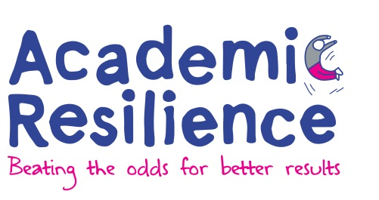
Understand academic resilience and what it would look like in your school
----Evidence base
----What works
Identify who is at risk if you do not ‘step up’ your support
----use data
----prepare for targeted support
Review
Plan
Do
Audit - How are we doing?
What can we improve?
Monitor change
Create baseline for
measuring change
Whole school community
School Development Plan
Notes:
Academic Resilience Approach – overview of the suggested school improvement process –

Slide 13
Schools and individual pupil data e.g. progress, risk factors etc
Identify lead; Reflections of SLT
Understand resilience
School community views
Existing pupil data
Reflection and learning
Strengths/weaknesses
IDEAS
Staff, pupils, parents, governors, community views. Eg surveys; focus groups;
Senior Leadership Team; staff together e.g. Inset workshop
Audit process
Do and Review
PLAN
Notes:
How to use an ‘audit’ approach to inform continuous improvement – gathering insight about how it isnow and generating ideas about what could be improved or introduced which, based on evidence, will promote Academic Resilience for those most disadvantaged or vulnerable pupils

Slide 14
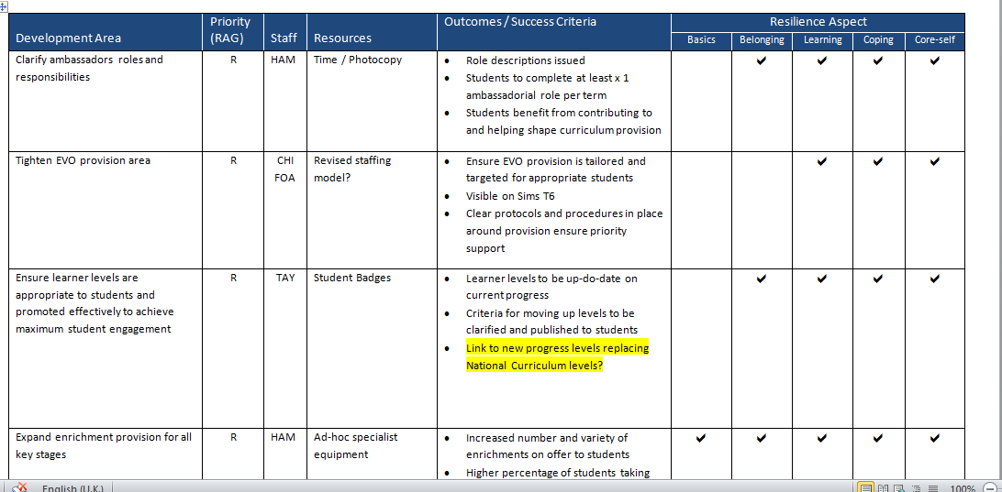
School Development Plan

Slide 15
Activities
5 times as many enrichments
Pyramid of need
Year group breakfasts
100 club
Kings “Characteristics”
Career of the week
“Family Lunch” in Exclusion Room
Curriculum re-design
Tighter focus on academic performance of the vulnerable
Action plans for vulnerable students with lead adults
Closer links to primary schools
Safe spaces at lunch and brunch
Wellbeing roles
Staff wellbeing activities
Notes:
Here’s an example of the activities which were suggested by staff and put in place at Kings College, Guildford following the audit and as part of their resilience project.

Slide 16
“Our school’s work on Academic Resilience has begun a transformation. .. The work has opened a door that allows staff to genuinely care and nurture …It gave us all the “permission” to show we care. We are now designing and implementing systems that really support the “whole person”. Since October we have launched 26 new initiatives (both small and large) under the resilience banner. Cumulatively, these changes and developments will lead to a bigger and brighter future for the young people in our school.”
Mark Taylor, Dep. Head and lead for the project

Slide 17
Eleanor Smith, Special School, Newham
Resilience project - Pulling together all the support we give to young people
‘Collaborative enquiry’ – all staff including cooks, cleaners, support staff
Gives us a common language in order to talk about the children’s needs and to help us meet those needs
Developed tools – drawing, talking, thinking
Notes:
Another example of a resilience project in a school using some of the materials on this website – from a school in London for children with Emotional Behavioural Difficulties.

Slide 18
Lionel
Agency Education Support Worker
‘Mrs Aldis was
her name…’
Notes:
Look out for the films on the site which gives more info on the work in schools and can be a great way to inspire staff alongside a presentation.

Slide 19
Contact YoungMinds for more information
Academic Resilience - beating the odds for better results, is an approach for schools devised by Lisa Williams and Professor Angie Hart and adopted by YoungMinds. Based on Professor Hart's collaborative resilience work at the University of Brighton and Boingboing, YoungMinds continues to work in partnership with them to develop the approach and support for schools.

